Slide 1
England
By Thomas Vardy

Slide 2
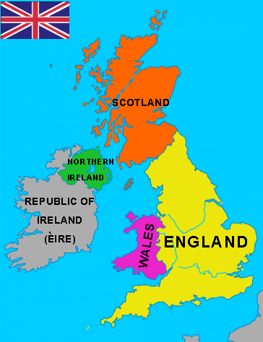
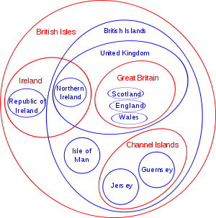
The UK
The UK is made up of 4 countries:
England
Wales
Scotland
Northern Ireland

Slide 3
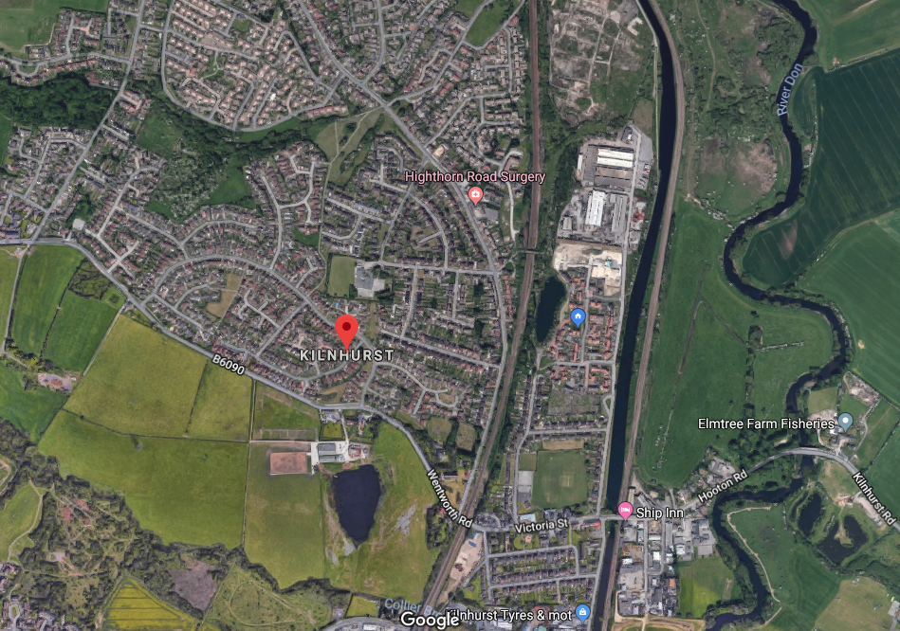
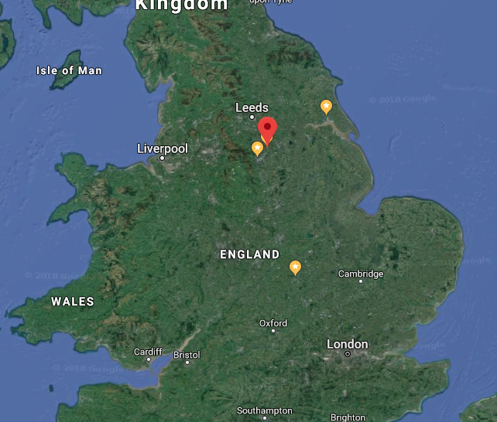
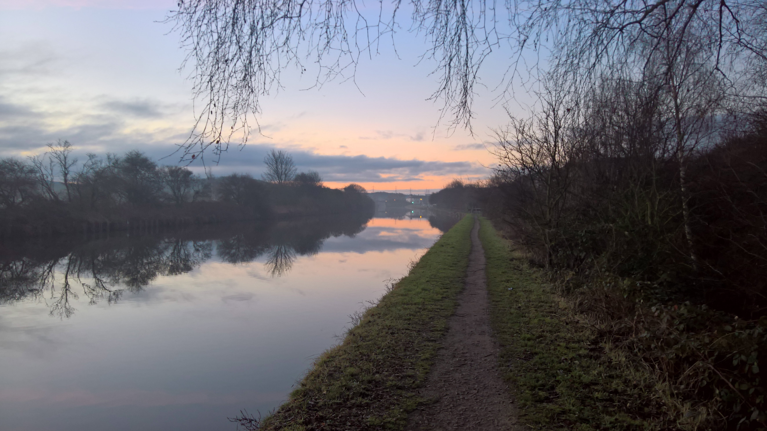
Where I live
I live in a small village not very
far away form Sheffield
Population: 2,775
Yorkshire
River Don
Is on the canal

Slide 4
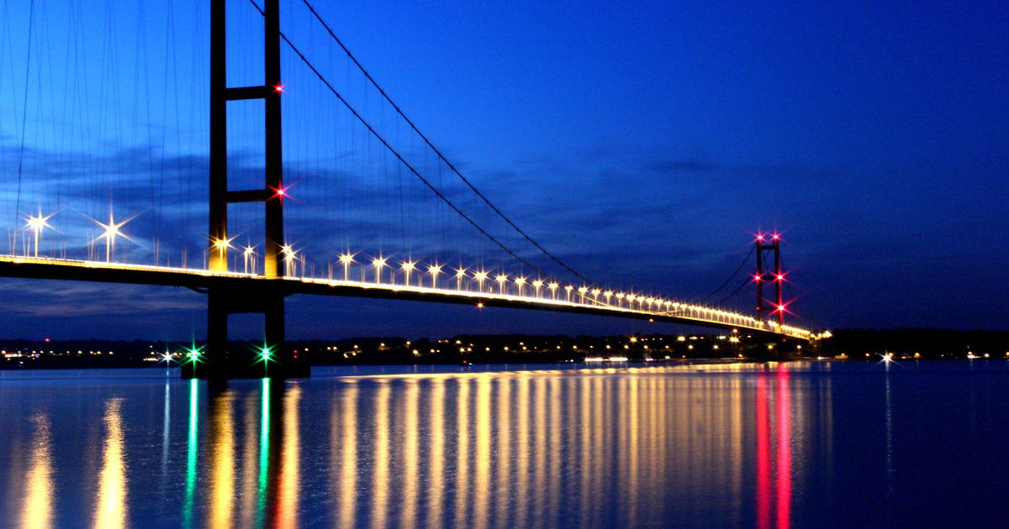
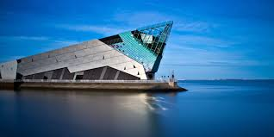
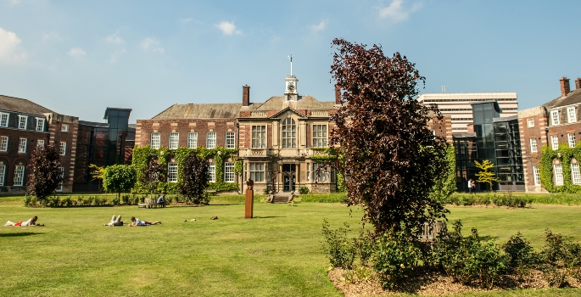
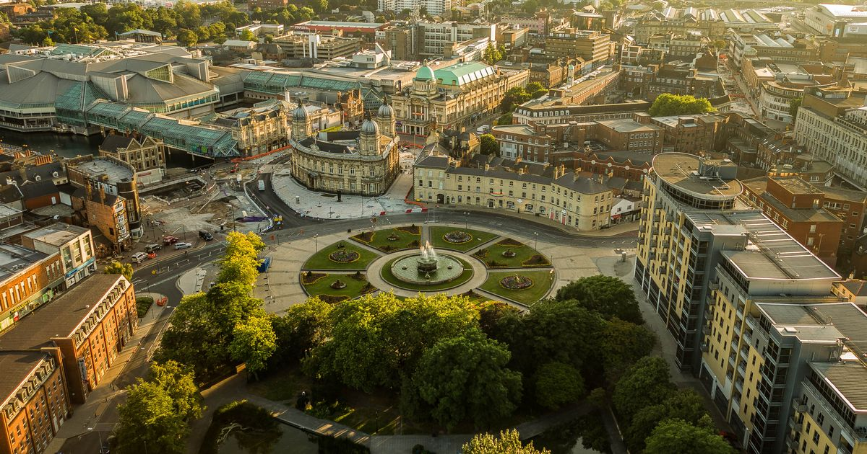
Where I study
I go to university in Hull which is a
costal city on the Humber river:
Population: 284,321
Humber bridge
The deep
City of culture 2017

Slide 5
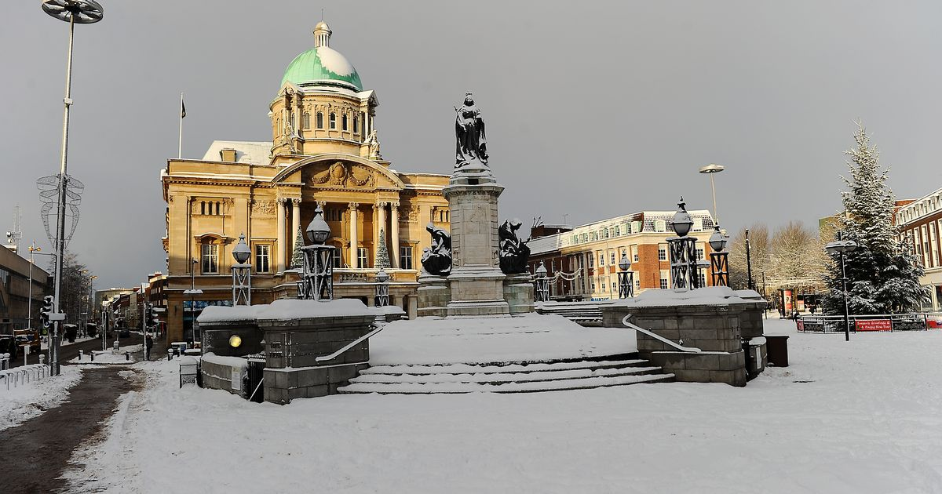
The weather
Winter
It snows most years
Summer
In the summer the temperature normally reaches 30
Average temperatures
Jan | Feb | Mar | April | May | Jun | July | Agu | Sept | Oct | Nov | Dec
3 | 4 | 7 | 9 | 12 | 15 | 17 | 16 | 14 | 11 | 8 | 5

Slide 6
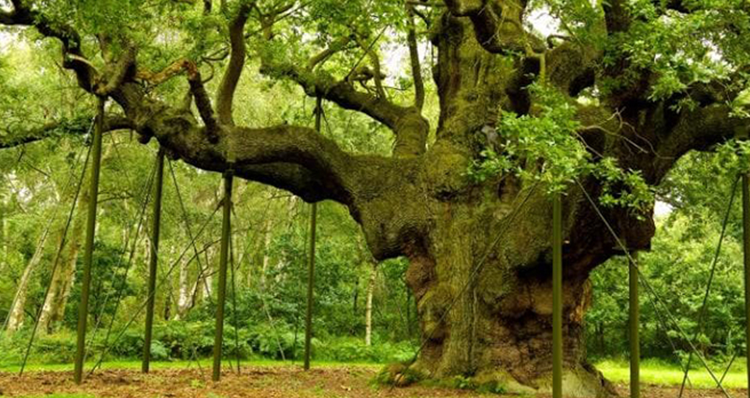
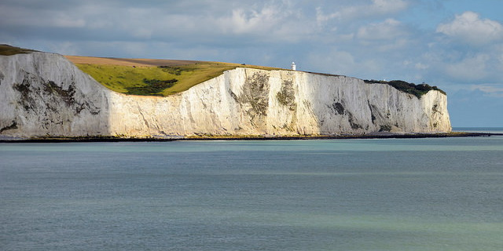
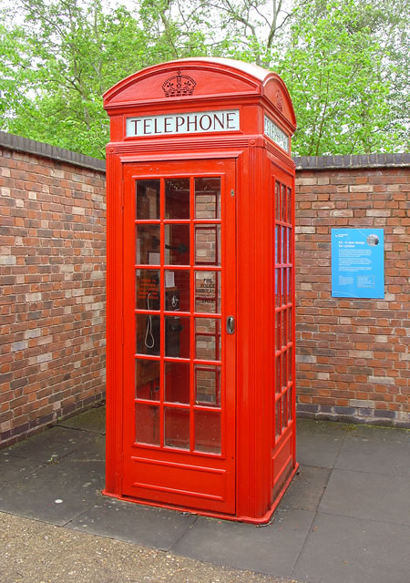
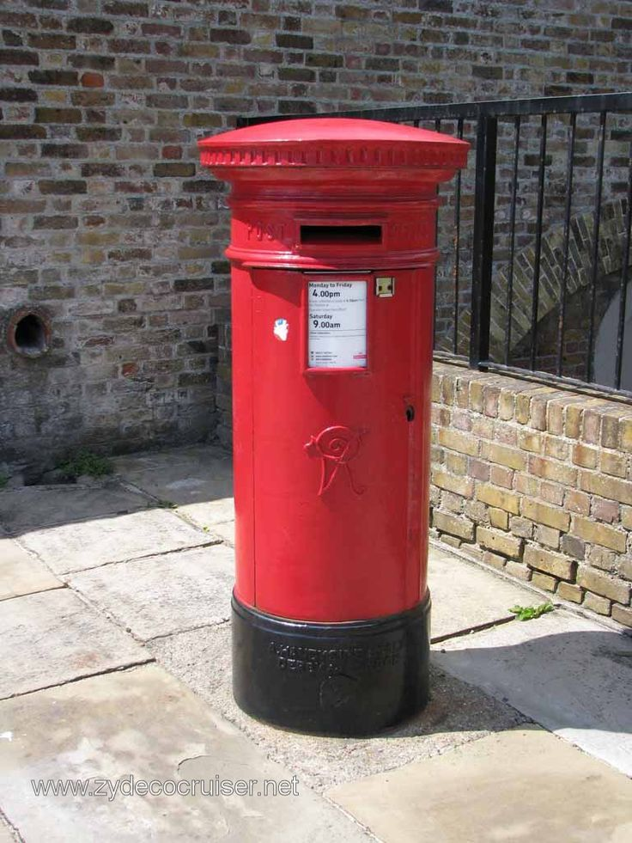
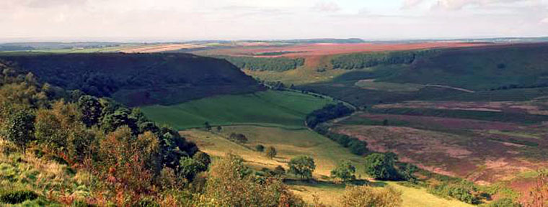
Famous landmarks
Sherwood forest
White cliffs of dover
Yorkshire moors
Iconic things
Telephone box
Post box

Slide 7
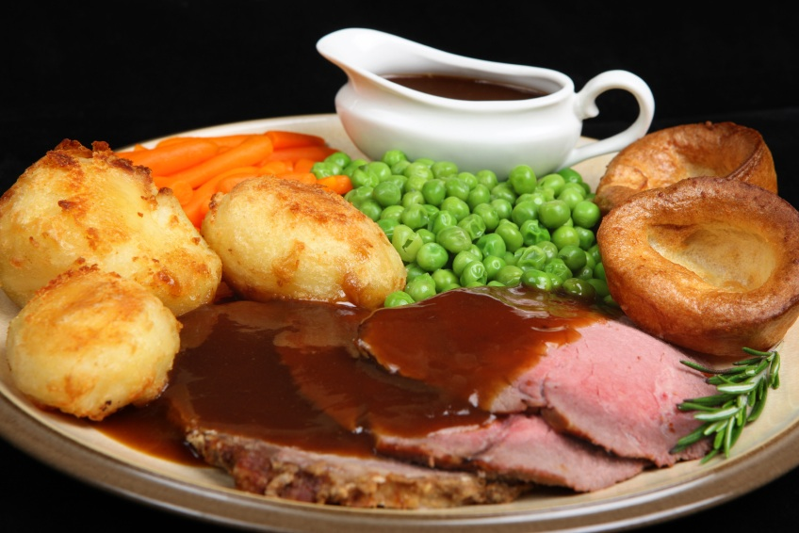
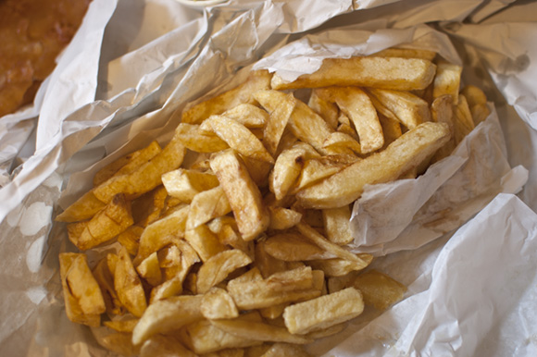
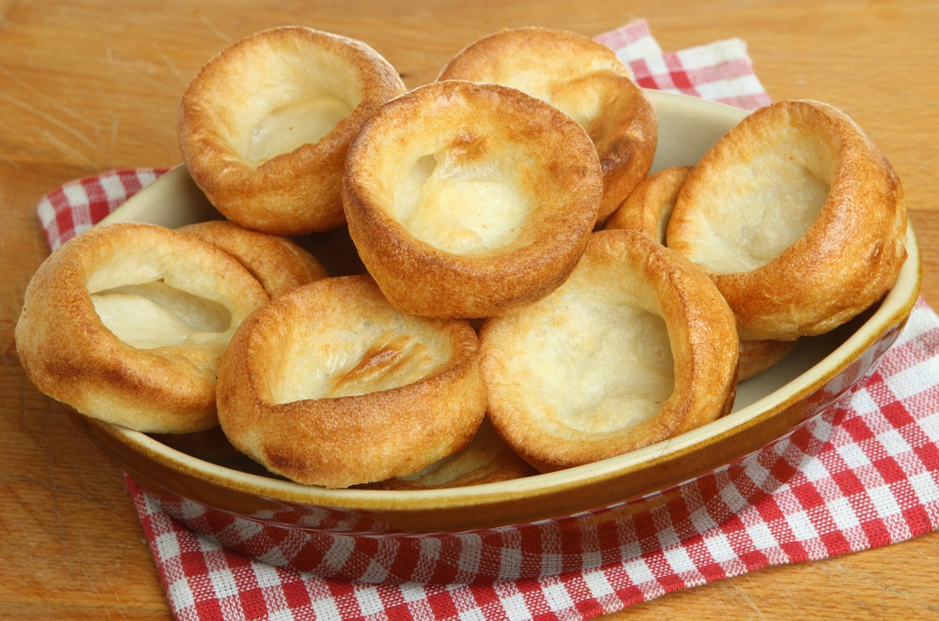
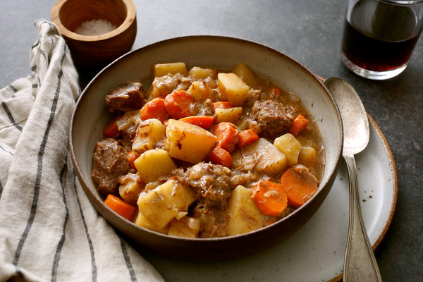
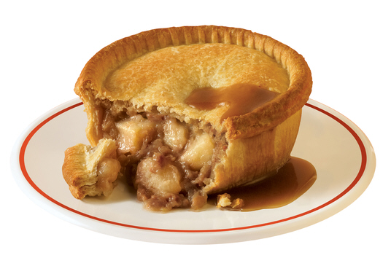
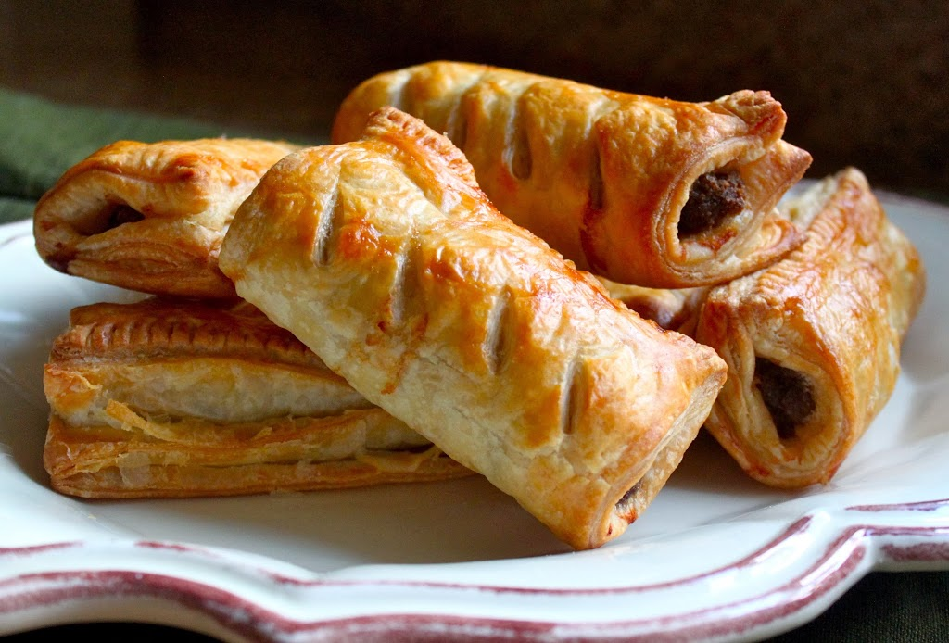
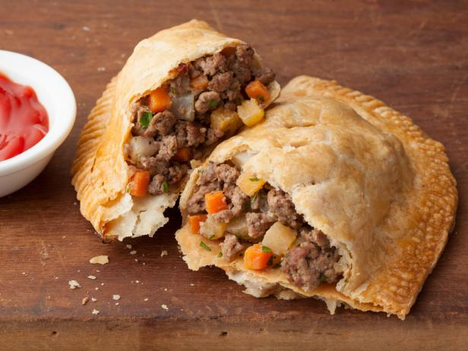
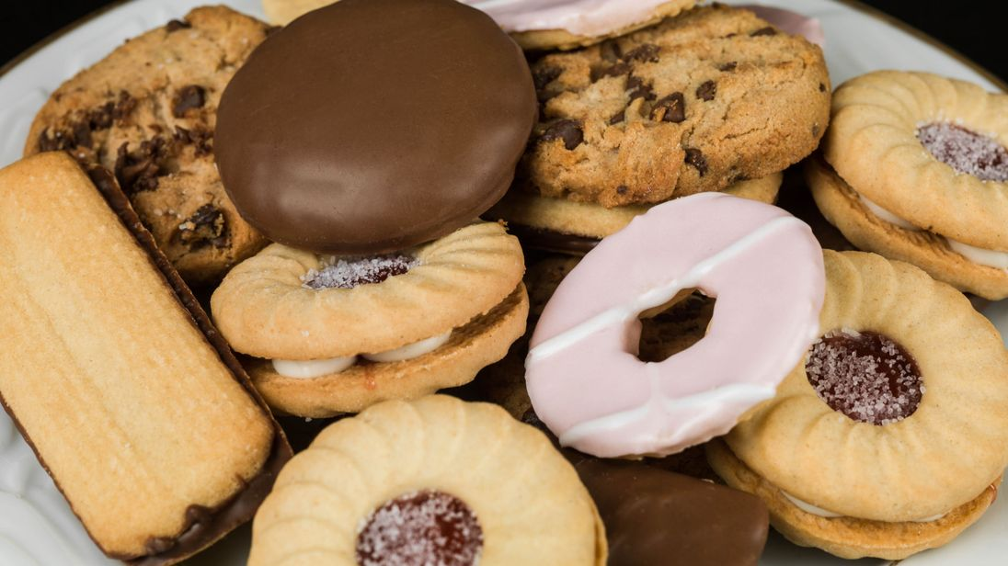
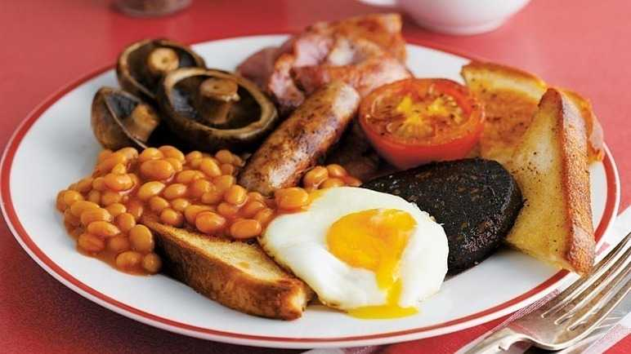
Food
Sunday dinner
Chips
Yorkshire puddings
Stew
Pie
Sausage rolls
Pasties
Biscuits
English breakfast

Slide 8
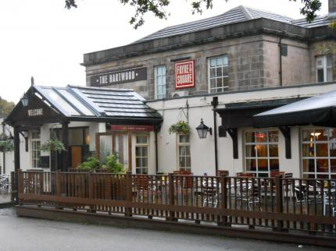
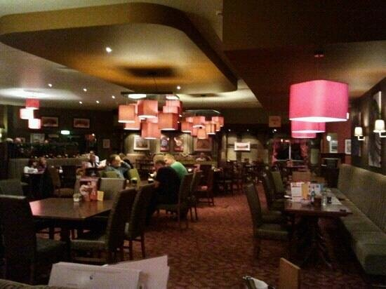
English Pubs
Pubs (public houses) in England are very popular and are a very popular pass time for people in england
They sell food and alcohol
They are usually very casual and cheap to buy food and drinks

Slide 9
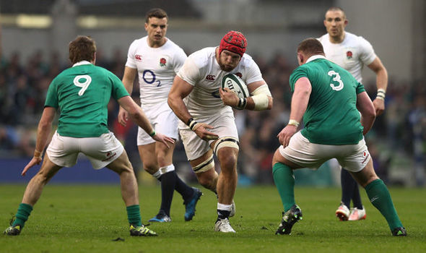
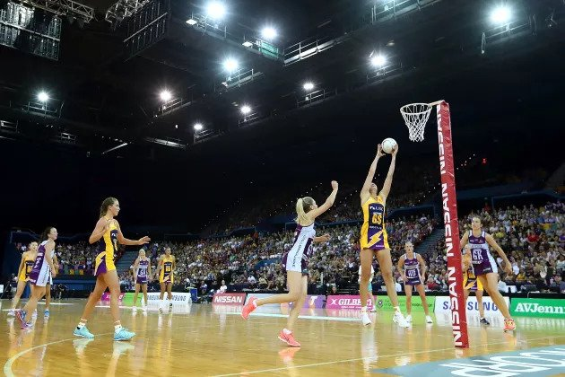
Sports
The most popular sport is football
But most schools have other sport teams:
football
Cricket
Rugby
Netball
Athletics
Running
Javelin
shock put
Jumping

Slide 10

Music
There's the top 40, which is music that’s on the radio on repeat
but most people have a smaller, specific group of music they like
I personally like indie, folk, electronic
Passenger
Keaton Henson
Imagine dragons
Seafret
The Lumineers
Owl city

Slide 11
TV Shows
There are a few very popular shows from the UK that are very popular over seas:
Downton abbey
Sherlock
Doctor who
Poldark
England is famous for its comedies, for example
Blackadder
Faulty towers
Peep show
IT Crowd (https://www.youtube.com/watch?v=vgFlZlQkSno)
The office
Only fools and horses
Fawlty towers
Mr. bean

Slide 12

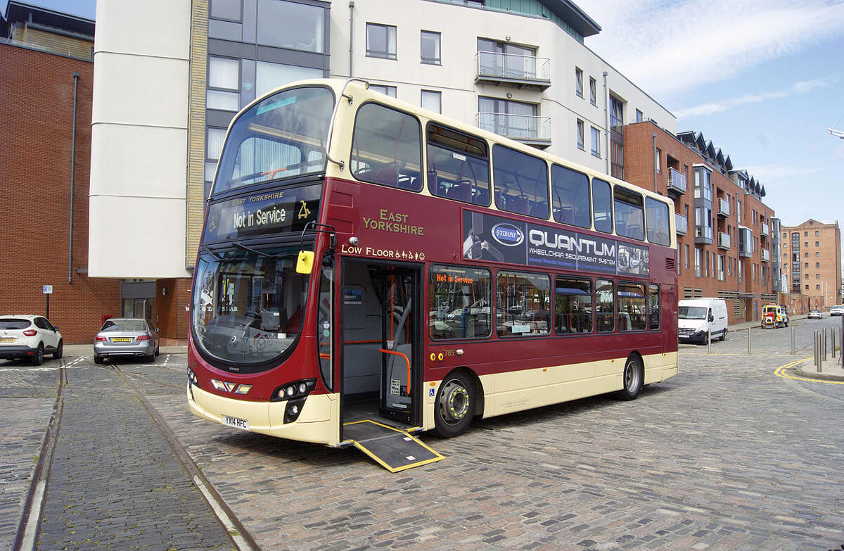
Big differences I've noticed
Smoking
Smoking is illegal in public in England
Cigarette packets have to be green in England to make them unappealing
Tipping
Tips are available but not often
Prices
Transport
Roads
Queues
No air con in England

Slide 13
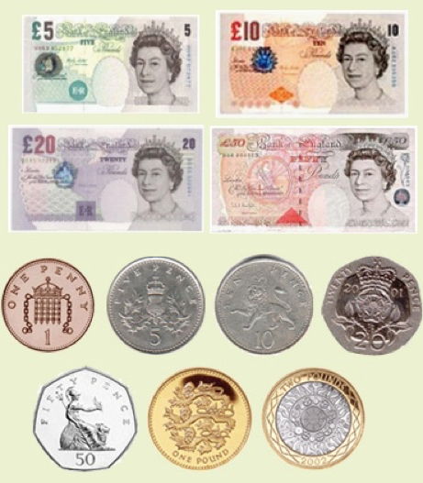
English money
1p = 0.089 yuan
5p = 0.45
10p = 0.89 yuan
20p = 1.79 yuan
50p = 4.47 yuan
£1 = 8.94 yuan
£2 = 17.88 yuan
£5 = 44.69 yuan
£10 = 89.38 yuan
£20 = 178.75 yuan

Slide 14
Thanks
Any questions?

